Slide 1
2018 Bethel Study Results
Trends in Affordability & Institutional Financial Health at CCCU Schools
Prepared By:
Dan Nelson: Chief Institutional Data & Research Officer
Stef Holm: Institutional Data & Research Senior Lead
Jeff Olson: Director of Financial Aid
November, 2018

Slide 2
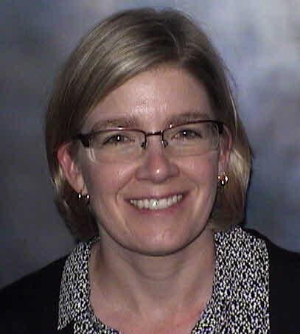
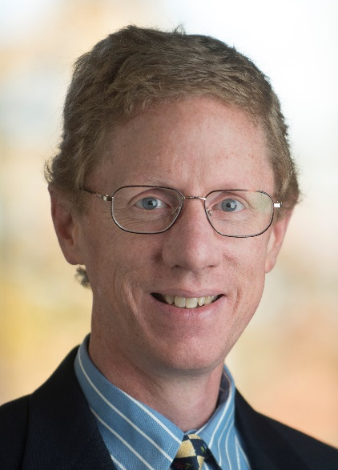

Authors
Stef Holm
Jeff Olson
Dan Nelson

Slide 3
Presentation Overview
1. Survey Participants
  Survey Demographics
  Enrollment
  Packaging
  Competitors
2. Financial Health Indicators
  Tuition & Fee Revenue
  Discount Rates
  Need
  Wealth Index
  Net Tuition Revenue
  3. Affordability Indicators
  Cost of Attendance Budgets
  Financial Aid
  Student Debt
  Net Price / Family Ability to Pay
  4. Implications for our Schools (discussion)

Slide 4
Survey Participants
Survey Demographics
Enrollment
Packaging
Competitors

Slide 5
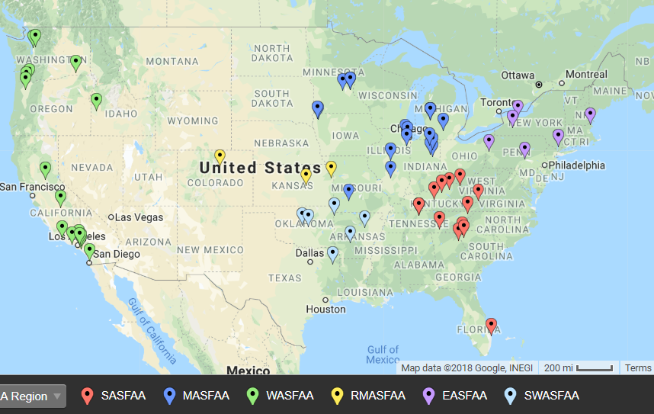
62 Participants – Nov. 18
http://batchgeo.com/

Slide 6
51 Schools Participated in at least
5 of the last 6 Surveys
135 schools participated in at least 1 survey
*Participated in all 20 surveys
Arizona Chr. Univ., AZ
Asbury Univ., KY
Bethel Univ., MN*
Biola Univ., CA
Bluefield Coll., VA
Calvin Coll., MI*
Campbellsville Univ., KY
Colorado Chr. Univ., CO
Columbia Internat. Univ., SC
Corban Univ., OR
Cornerstone Univ., MI
Crown Coll., MN
Dordt Coll., IA
Emmanuel Coll., GA
Evangel Univ., MO
Fresno Pacific Univ., CA
Geneva Coll, PA
George Fox Univ., OR
Gordon Coll., MA
Grace Coll., IN
Greenville Coll., IL
Hope International Univ., CA
Houghton Coll., NY*
Huntington Univ., IN
Indiana Wesleyan Univ., IN
John Brown Univ., AR*
Lee Univ., TN
LeTourneau Univ., TX
Lincoln Chr. Univ., IL
Lipscomb Univ., TN
Messiah Coll., PA*
MidAmerica Nazarene Univ., KS
Milligan Coll., TN
Moody Bible Institute, IL
Nyack Coll., NY
Oklahoma Baptist Univ., OK
Oklahoma Chr. Univ., OK
Olivet Nazarene Univ., IL
Point Loma Nazarene Univ., CA
Roberts Wesleyan Coll., NY*
Simpson Univ., CA
Spring Arbor Univ., MI
Sterling Coll., KS
Taylor Univ., IN*
Trevecca Nazarene Univ., TN
Trinity Chr. Coll., IL
Univ. of Northwestern, MN*
Warner Pacific Coll., OR
Westmont Coll., CA*
Wheaton Coll., IL
William Jessup Univ., CA

Slide 7
2017-’18 Enrollment (see p. 4)
Of the 62 respondents:
  49 (79%) report non-traditional undergrads
  56 (90%) report graduate students
Total Fall ‘17 undergraduate enrollment in traditional programs was 102,881 (for the 62 reporting schools).
Total year grad and undergrad enrollment was 206,922 (as reported on FISAP)
Notes:
)

Slide 8
Traditional Undergraduate Programs

Slide 12
% of Institutionally Controlled Gift Aid (ICGA) (p. 242ff.)
Traditional Undergraduate Programs

Slide 13
Frequently Named Competitors (p. 254ff.)
# Times Listed as Competitor
Type of Competition?
12 Azusa Pacific University, CA
10 Biola University, CA
9 Wheaton College, IL
8 California Baptist University, CA
6 George Fox University, OR
6 Indiana Wesleyan University-Marion, IN
5 Bethel University, MN
5 Westmont College, CA
5 Olivet Nazarene University, IL
5 Calvin College, MI
5 Dordt College, IA
5 Whitworth University, WA
CCCU
  2017-18 = 39%
  2013-14 = 41%
  2009-10 = 42%
Other Private
  2017-18 = 21%
  2013-14 = 20%
  2009-10 = 21%
Publics
  2017-18 = 40%
  2013-14 = 39%
  2009-10 = 37%
46% of responding schools identified a public institution as their #1 competitor (24/52)
Q. Who are your top 7-10 competitors (in traditional undergraduate programs)?

Slide 14
Financial Health Indicators: Institution Perspective
  Tuition & Fee Revenue
  Discount Rates
  Need
  Wealth Index
  Net Tuition Revenue

Slide 15
Tuition and Fee Revenue (see p. 18)
Year | Traditional Programs | Non-Traditional Programs | Graduate Programs
‘08-’09 | 81.6% | 8.9% | 9.5%
‘09-10 | 79.5% | 9.3% | 11.3%
‘10-’11 | 79.1% | 8.8% | 12.1%
‘11-’12 | 78.5% | 10.0% | 11.5%
‘12-’13 | 80.2% | 8.2% | 11.6%
’13-’14 | 80.5% | 8.5% | 11.0%
’14-’15 | 78.8% | 8.8% | 12.4%
’15-’16 | 79.3% | 8.5% | 12.2%
‘16-’17 | 79.6% | 7.3% | 13.1%
‘17-’18 | 74.1% | 6.9% | 19.0%
The 62 responding schools reported ’17-’18 tuition & fee revenue of $3.89 Billion
Extrapolating to the entire CCCU membership, tuition & fee revenue at CCCU schools is over $6 Billion annually.

Slide 16
How Dependent are Schools on Student and Family Loans? (see p. 63)
Traditional Undergraduate Programs
Recorded loans (including PLUS) exceed 50% of tuition & fee revenue at only 2 of 62 reporting schools (3%)
  2% on 2017 survey
Loans are less than 30% of tuition and fee revenue at 39 of 62 schools (63%)
  52% on 2017 survey
The median percentage is 27.6%, compared with
  29.3% on 2017 survey
  31.0% on 2016 survey
  32.9% on 2015 survey

Slide 17
Percentage of 2017-18 Institutional Gift Aid (IGA) that is “funded” (see p. 43)
Traditional Undergraduate Programs
The typical (median) school reports that 3.9% of institutional gift aid (not including tuition remission) has a specific funding source (endowed or restricted).
  3 schools report that over 15% of IGA is funded.
  9 schools report between 10-15% of IGA is funded
  15 schools report between 5.0-9.9% of IGA is funded
  35 schools report that less than 5% of IGA is funded

Slide 18
Discount Rate Calculation
Unfunded
  "Unrestricted Institutional gift aid" divided by "tuition and fee revenue"
NACUBO
  (Unrestricted institutional gift aid + endowed + restricted) divided by "tuition and fee revenue"
Neither calculation includes employee tuition remissions

Slide 19
2017-18 Discount Rates (All Students)
(see pp. 117-122)
Traditional Undergraduate Programs
62 schools reported Unfunded discount rates from 14.5% to 59.5% (next lowest was 26.6%)
  1st Quartile: 39.9% (38.5 last year)
  2nd Quartile (median): 43.3% (41.9% last year)
  3rd Quartile: 47.4% (46.7% last year)
The NACUBO discount rate for the same schools ranged from 29.5% to 61.0%
  1st Quartile: 43.2% (41.3% last year)
  2nd Quartile (median): 46.1% (43.8% last year)
  3rd Quartile: 50.2% (50.6% last year)

Slide 20
Traditional Undergraduate Programs

Slide 21
Traditional Undergraduate Programs

Slide 23


Slide 24
“Target” Unfunded Discount Rate for 2018-19 New Students (see p. 131)
Traditional Undergraduate Programs
 | New Student Target Rate | All Student Estimated Rate | Range of Differences
Minimum | 20.0% | 26.5% | -8.9 points
First Quartile | 45.0% | 40.8% | +0.4 points
Median | 50.0% | 45.6% | +3.7 points
Third Quartile | 56.0% | 49.4% | +9.0 points
Maximum | 62.4% | 60.5% | +21.5 points
The “Range of Differences” column illustrates the range of the gap between the “new student target discount rate” at 55 responding schools and the “estimated 18-19 unfunded discount rate for all students” at the same schools.
A negative “range of differences” means that the target new student rate at a school is less than their estimated overall discount rate, and vise versa.

Slide 25
2017-18 Needy/Not Needy
(see p. 145)
Traditional Undergraduate Programs
69.7%* percent of students at 57 responding schools were needy (range: 45.6% to 98.0%).
  Total gift aid to needy students = $1.25 billion
  Average total gift aid per needy student = $18,217 ($16,909 last year)
  * weighted average

Slide 26
Traditional Undergraduate Programs

Slide 27

How Needy are our Students?
(see p. 149)
Traditional Undergraduate Programs
The average needy student in 2017-18 at responding schools had demonstrated need of $30,475 (range: $15,619 to $52,581)
On average, responding schools meet 59.7% of need with gift aid
  Minimum: 40.2%
  1st Quartile: 55.0%
  2nd Quartile (median): 59.5%
  3rd Quartile: 65.6%
  Maximum: 82.8%

Slide 28
Traditional Undergraduate Programs

Slide 29
2017-18 Non-Need Students
(see p. 171ff.)
Traditional Undergraduate Programs
Percentage of non-need students receiving gift aid
19 of 56 (34%) schools gave non-need gift aid to over 97% of their non-need students
  Minimum = 18.9%
  1st quartile = 80.9%
  Median = 93.8%
  3rd quartile = 98.3%
  Max = 100% (11 schools)
Average total gift aid per non-need aid recipient
  Minimum = $3,521
  1st quartile = $11,141
  Median = $13,419
  3rd quartile = $15,984
  11 schools over $17,000
  Max = $29,455
Weighted average total gift aid per needy recipient $18,386

Slide 30
Price compared with Family Wealth
(see p. 158ff.)
Traditional Undergraduate Programs
The "wealth index" is an approximate measurement of expected parent contribution from non-independent student families (whether or not they show need).
A positive variance means that, compared to other reporting schools, families are wealthier than the norm.

Slide 31
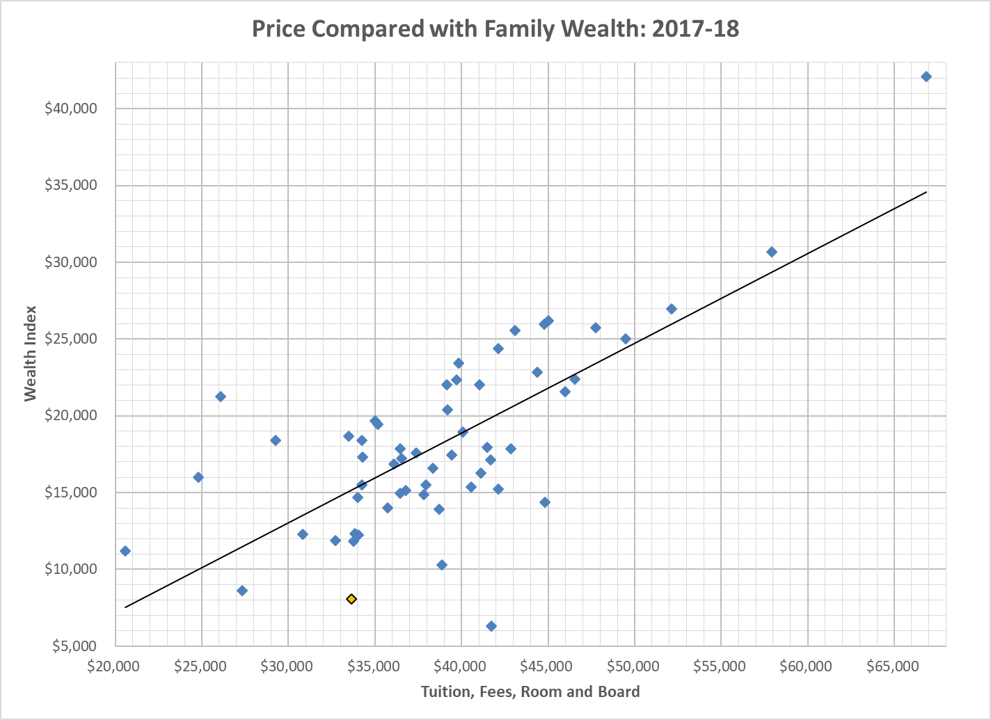
Price Compared with Family Wealth: 2017-18
Traditional Undergraduate Programs

Slide 32
Traditional Undergraduate Programs

Slide 33
Traditional Undergraduate Programs

Slide 34
Affordability Indicators for Traditional Undergraduate Programs: Student’s Perspective
  Cost of Attendance Budgets
  Financial Aid
  Student Debt
  Net Price / Family Ability to Pay

Slide 35
2018-19 On-campus Budgets (COA for students in Traditional Undergrad Programs) (see p. 20ff.)
Traditional Undergraduate Programs
Average on-campus student budget is $43,864
  Lincoln Christian $26,581
  Pepperdine $73,002
This is an increase of 5.6% from 2017-18 (compared with a 3.3% increase from 2016-17 to 2017-18).
  Up 4.4% without Pepperdine.

Slide 36
Traditional Undergraduate Programs

Slide 37
Traditional Undergraduate Programs

Slide 38
Traditional Undergraduate Programs

Slide 39
Traditional Undergraduate Programs

Slide 40
Traditional Undergraduate Programs

Slide 41
2017-18 Borrowing: Average per Enrolled Student (see p. 61-62)
Traditional Undergraduate Programs
Perkins $177
Subsidized $2,177
Unsubsidized $2,042
Other $1,261
PLUS $1,846
Total $7,503

Slide 42
Traditional Undergraduate Programs

Slide 43
Traditional Undergraduate Programs

Slide 44
Traditional Undergraduate Programs

Slide 45
Average Student Loan Debt
(see p. 93ff.)
Traditional Undergraduate Programs
On average 72% of FY18 graduates at 60 responding schools borrowed student loans (range: 44% to 100%).
Their average debt was $29,570 (range: $14,194 to $39,930).
  30 of 60 (50%) of responding schools had average debts ranging from $26,660 to $33,088
The average debt, at schools where students borrowed, equaled 102% of 2017-2018 tuition and fees at each student’s school (range: 40% to 212%).

Slide 46
3-Year Cohort Default Rates
Most recent three-year default rate on government loans (FY2015 official).
National Average Default Rate – All Schools (10.8%)
National Average Default Rate – Private 4-Year (6.6%)
SOURCE: U.S. Department of Education Default Management, Official Cohort Default Rates for Schools, retrieved 12.20.2018 https://www2.ed.gov/offices/OSFAP/defaultmanagement/cdr.html

Slide 47
Traditional Undergraduate Programs

Slide 48
Traditional Undergraduate Programs

Slide 49
Implications for our Schools (discussion)

Slide 50

Questions?
Contact Dan Nelson or Jeff Olson if you have specific questions
  dc-nelson@bethel.edu
  jeff-olson@bethel.edu
Email the CCCU financial aid administrators e-list to foster a broader conversation

