Slide 1
2018 Bethel Study Results
Trends in Affordability & Institutional Financial Health at CCCU Schools
February 12, 2019 – St. Petersburg, FL
Presenters
Dan Nelson: Chief Institutional Data & Research Officer
Jeff Olson: Director of Financial Aid

Slide 2
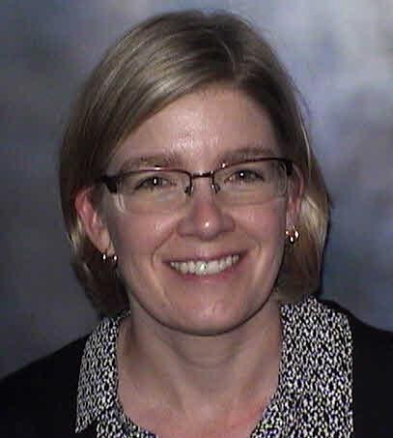
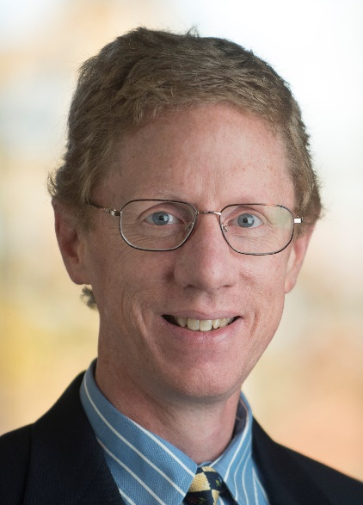

Authors
Stef Holm
Jeff Olson
Dan Nelson

Slide 3
Presentation Overview
1. Survey Participants
  Survey Demographics
  Enrollment
2. 2018 Survey Themes
  Timing of New Student Awards
  Student Wage Rates
  Packaging
    Need Analysis
    Use of Consultants
    Net Price Calculator
  Financial Aid Director Role
  Competitors
  Appeals & Adjustments
  Financial Aid Conferences
3. Financial Health Indicators
  Tuition & Fee Revenue
  Discount Rates
  Need
  Wealth Index
  Net Tuition Revenue
  4. Affordability Indicators
  Cost of Attendance Budgets
  Financial Aid
  Student Debt
  Net Price / Family Ability to Pay
  5. Implications for our Schools (discussion)

Slide 4
Survey Participants
Survey Demographics
Enrollment

Slide 5
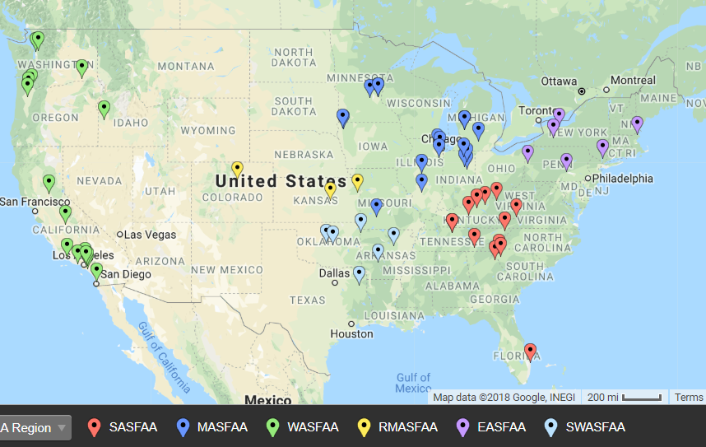
62 Participants – Nov. 18
http://batchgeo.com/
Notes:
Load demographic data into the following website to generate map
https://batchgeo.com/
https://batchgeo.com/map/f00246fbee090081ded05535ace4d44b

Slide 6
9 Schools
Participated in all 20 studies
Bethel University, MN
Calvin College, MI
Houghton College, NY
John Brown University, AR
Messiah College, PA
Roberts Wesleyan College, NY
Taylor University, IN
University of Northwestern - St Paul, MN
Westmont College, CA

Slide 7
2017-’18 Enrollment (see p. 4)
Of the 62 respondents:
  49 (79%) report non-traditional undergrads
  56 (90%) report graduate students
Total Fall ‘17 undergraduate enrollment in traditional programs was 102,881 (for the 62 reporting schools).
Total year grad and undergrad enrollment was 206,922 (as reported on FISAP)
Notes:
Non-trad 1415: 75%
Grad 1415: 92%
Undergrad trad enrollment 1415: 116,580
Total enrollment 1415: 238,311
Non-trad 75% last year (1314)
Grad 89% last year (1314)

Slide 8
Traditional Undergraduate Programs

Slide 12
2018 Survey Themes
Timing of New Student Awards
Student Wage Rates
Packaging
Financial Aid Director Role
Competitors
Appeals & Adjustments
Financial Aid Conferences

Slide 13
Timing of New Student Awards for 2019 (see p. 252ff.)
Traditional Undergraduate Programs
When will you begin awarding new students for 2019-20?
  41% starting November 2018.
  44% starting December 2018
  10% starting January 2019
  3% starting February 2019
  2% starting March 2019 or later
Notes:
When will you begin awarding new students for 2018-19?
50.0% starting November 2017.
40.3% starting December 2017
6.5% starting January 2018
1.6% starting February 2018
1.6% starting March 2018 or later
When will you begin awarding new students for 2017-18?
53.1% starting November 2016.
32.8% starting December 2016
7.8% starting January 2017
1.5% starting February 2017
4.6% starting March 2017 or later
Change: from F’17 to F’18 awarding
Earlier = 8; 16.0%
Same Month= 33; 66.0%
Later = 9; 18.0%

Slide 14
Avg. Total Pay per RA as % of Room & Board: 2017-18
Traditional Undergraduate Programs

Slide 15
How do you determine “Need”?
(see p. 198ff.)
Of 62 reporting schools:
  54 (87%) use FM exclusively (compared with 89% in 2014)
  8 schools (13%) use FM and some other method of need analysis (down from 9 schools in 2014)
    0 schools reported using CSS Profile (same as 2014)

Slide 16
% of Institutionally Controlled Gift Aid (ICGA) awarded based on Need (p. 242ff.)
Traditional Undergraduate Programs

Slide 17
% of Institutionally Controlled Gift Aid (ICGA) awarded based on Need (p. 242ff.)
Traditional Undergraduate Programs
Awarded for Need or Merit, but Meets Need

Slide 18
% of Institutionally Controlled Gift Aid (ICGA) (p. 242ff.)
Traditional Undergraduate Programs

Slide 19
What criteria would the director of financial aid prefer to use to award institutional gift aid? (p. 244ff.)
 | 2010 Survey | 2014 Survey | 2018 Survey
Only need | 1 (2%) | 2 (3%) | 2 (3%)
Need more than Merit | 16 (24%) | 23 (29%) | 21 (34%)
Need & Merit Equally | 44 (67%) | 42 (54%) | 25 (40%)
Merit more than Need | 5 (8%) | 11 (14%) | 11 (18%)
Only Merit | 0 (0%) | 0 (0%) | 1 (2%)

Slide 20
Hired a Financial Aid Consultant in last 5 Years? (see p. 200ff.)
43 Yes (69%)
Most frequently named consultants
  Ruffalo Noel Levitz (25 times)
  EAB (Hardwick-Day) (8 times)
  Scannell & Kurz (3 times)
  No others reported more than twice

Slide 21
Use of Net Price Calculators
(pp. 204-207)
12 schools (19%) use the federally supplied NPC
4 schools (6%) developed their own NPC
46 schools (74%) use a vendor (see next slide)
If not required, would you still use your NPC?
  24 yes
  37 no

Slide 22
Net Price Calculator Vendors and Satisfaction Level (p. 177)
Vendor | # Schools | Satisfaction (4 highest)
Ruffalo Noel Levitz | 20 | 2.9
College Raptor | 10 | 2.2
Campus Logic | 6 | 3.5
College Board | 4 | 2.7
Hardwick Day/EAB | 2 | 3.0
AidCalc | 1 | 2.0
Cegment | 1 | 0.0
Enrollment Research | 1 | 2.0
Slate | 1 | 3.3
All Vendors | 46 | 2.7

Slide 23
Financial Aid Director’s Involvement In…(p. 210ff)
Q. To what extent is the financial aid director involved in the following activities? 1. Direct involvement (participate in decision); 2. Indirect involvement (provide data/input to decision maker); 3. Not involved

Slide 24
Frequently Named Competitors (p. 254ff.)
# Times Listed as Competitor
Type of Competition?
12 Azusa Pacific University, CA
10 Biola University, CA
9 Wheaton College, IL
8 California Baptist University, CA
6 George Fox University, OR
6 Indiana Wesleyan University-Marion, IN
5 Bethel University, MN
5 Westmont College, CA
5 Olivet Nazarene University, IL
5 Calvin College, MI
5 Dordt College, IA
5 Whitworth University, WA
CCCU
  2017-18 = 39%
  2013-14 = 41%
  2009-10 = 42%
Other Private
  2017-18 = 21%
  2013-14 = 20%
  2009-10 = 21%
Publics
  2017-18 = 40%
  2013-14 = 39%
  2009-10 = 37%
Q. Who are your top 7-10 competitors?

Slide 25
Do you make Professional Judgment Adjustments in these situations? (p. 224ff.)

Slide 26
Do you make PJ Adjustments in these situations? (p. 224ff.)

Slide 27
Do you make PJ Adjustments in these situations? (p. 224ff.)

Slide 28
# of Attendees by Conference: 2018 Survey (p. 246ff.)
2018-19 Planned Conference Attendance | # Director, Dean, VP Attend | # Ast/Assoc Dir Attend | # Counselor/ Other Attend | Total | % of Grand Total
State 1 | 26 | 33 | 59 | 118 | 30%
FSA | 30 | 26 | 37 | 93 | 23%
Software Vendor | 13 | 19 | 13 | 45 | 11%
State 2 | 8 | 10 | 24 | 42 | 11%
NASFAA | 18 | 5 | 7 | 30 | 8%
Regional | 8 | 9 | 11 | 28 | 7%
CCCU | 22 | 4 | 0 | 26 | 7%
Other | 6 | 6 | 4 | 16 | 4%
Grand Total | 131 | 112 | 155 | 398

Slide 29
Financial Health Indicators: Institution Perspective
  Tuition & Fee Revenue
  Discount Rates
  Need
  Wealth Index
  Net Tuition Revenue

Slide 30
Tuition and Fee Revenue (see p. 18)
Year | Traditional Programs | Non-Traditional Programs | Graduate Programs
‘08-’09 | 81.6% | 8.9% | 9.5%
‘09-10 | 79.5% | 9.3% | 11.3%
‘10-’11 | 79.1% | 8.8% | 12.1%
‘11-’12 | 78.5% | 10.0% | 11.5%
‘12-’13 | 80.2% | 8.2% | 11.6%
’13-’14 | 80.5% | 8.5% | 11.0%
’14-’15 | 78.8% | 8.8% | 12.4%
’15-’16 | 79.3% | 8.5% | 12.2%
‘16-’17 | 79.6% | 7.3% | 13.1%
‘17-’18 | 74.1% | 6.9% | 19.0%
The 62 responding schools reported ’17-’18 tuition & fee revenue of $3.89 Billion
Extrapolating to the entire CCCU membership, tuition & fee revenue at CCCU schools is over $6 Billion annually.
Notes:
9.2% of tuition comes from non-traditional undergrads (8.5% in ’06-’07; 9.2% in ‘05-’06)
11.2% of tuition is from graduate students (10.5% in ‘06-07; 9.5% in ’05-’06)
The percent of tuition from traditional undergrads decreased from 81.3% in ’05-’06; to 81.0% in ’06-’07; to 79.6% in ‘08-'09

Slide 31
How Dependent are Schools on Student and Family Loans? (see p. 63)
Traditional Undergraduate Programs
Recorded loans (including PLUS) exceed 50% of tuition & fee revenue at only 2 of 62 reporting schools (3%)
  2% on 2017 survey
Loans are less than 30% of tuition and fee revenue at 39 of 62 schools (63%)
  52% on 2017 survey
The median percentage is 27.6%, compared with
  29.3% on 2017 survey
  31.0% on 2016 survey
  32.9% on 2015 survey
Notes:
2017 story – we’re less reliant on loans

Slide 32
Percentage of 2017-18 Institutional Gift Aid (IGA) that is “funded” (see p. 43)
Traditional Undergraduate Programs
The typical (median) school reports that 3.9% of institutional gift aid (not including tuition remission) has a specific funding source (endowed or restricted).
  3 schools report that over 15% of IGA is funded.
  9 schools report between 10-15% of IGA is funded
  15 schools report between 5.0-9.9% of IGA is funded
  35 schools report that less than 5% of IGA is funded
Notes:
Fall 2015 survey data (2014-15) below:
5 schools report that over 15% of IGA is funded.
10 schools report between 10-15% of IGA is funded
13 schools report between 5.0-9.9% of IGA is funded
47 schools report that less than 5% of IGA is funded
Fall 2016 data below
The typical (median) school reports that 4.1% of institutional gift aid (not including tuition remission) has a specific funding source (endowed or restricted).
3 schools report that over 15% of IGA is funded.
4 schools report between 10-15% of IGA is funded
18 schools report between 5.0-9.9% of IGA is funded
39 schools report that less than 5% of IGA is funded

Slide 33
Discount Rate Calculation
Unfunded
  "Unrestricted Institutional gift aid" divided by "tuition and fee revenue"
NACUBO
  (Unrestricted institutional gift aid + endowed + restricted) divided by "tuition and fee revenue"
Neither calculation includes employee tuition remissions

Slide 34
2017-18 Discount Rates (All Students)
(see pp. 117-122)
Traditional Undergraduate Programs
62 schools reported Unfunded discount rates from 14.5% to 59.5% (next lowest was 26.6%)
  1st Quartile: 39.9% (38.5 last year)
  2nd Quartile (median): 43.3% (41.9% last year)
  3rd Quartile: 47.4% (46.7% last year)
The NACUBO discount rate for the same schools ranged from 29.5% to 61.0%
  1st Quartile: 43.2% (41.3% last year)
  2nd Quartile (median): 46.1% (43.8% last year)
  3rd Quartile: 50.2% (50.6% last year)
Notes:
NACUBO last year 25.2% to 61.8%

Slide 35
Traditional Undergraduate Programs

Slide 36
Traditional Undergraduate Programs

Slide 37
“Target” Unfunded Discount Rate for 2018-19 New Students (see p. 131)
Traditional Undergraduate Programs
 | New Student Target Rate | All Student Estimated Rate | Range of Differences
Minimum | 20.0% | 26.5% | -8.9 points
First Quartile | 45.0% | 40.8% | +0.4 points
Median | 50.0% | 45.6% | +3.7 points
Third Quartile | 56.0% | 49.4% | +9.0 points
Maximum | 62.4% | 60.5% | +21.5 points
The “Range of Differences” column illustrates the range of the gap between the “new student target discount rate” at 55 responding schools and the “estimated 18-19 unfunded discount rate for all students” at the same schools.
A negative “range of differences” means that the target new student rate at a school is less than their estimated overall discount rate, and vise versa.

Slide 38
2017-18 Needy/Not Needy
(see p. 145)
Traditional Undergraduate Programs
69.7%* percent of students at 57 responding schools were needy (range: 45.6% to 98.0%).
  Total gift aid to needy students = $1.25 billion
  Average total gift aid per needy student = $18,217 ($16,909 last year)
  * weighted average
Notes:
Fall 2016 survey (2015-16 data)
Weighted Avg: 69,119 needy students / 98,754 FISAP enrollment for schools who reported needy students= 70.0%
Fall 2015 survey below (2014-15 data)
73.1% percent of students at 74 responding schools were needy (range: 30.6% to 92.5%). [update 11.29.2016 unweighted avg 72.1%; weighted avg 71.1%]
Total gift aid to needy students = $1.36 billion
Average gift aid per needy student = $15,041 ($14,601 last year)
Fall 2016 slide:
70.0%* percent of students at 64 responding schools were needy (range: 44.8% to 90.0%).
Total gift aid to needy students = $1.05 billion
Average total gift aid per needy student = $15,843 ($15,041 last year)

Slide 39
Traditional Undergraduate Programs

Slide 40

How Needy are our Students?
(see p. 149)
Traditional Undergraduate Programs
The average needy student in 2017-18 at responding schools had demonstrated need of $30,475 (range: $15,619 to $52,581)
On average, responding schools meet 59.7% of need with gift aid
  Minimum: 40.2%
  1st Quartile: 55.0%
  2nd Quartile (median): 59.5%
  3rd Quartile: 65.6%
  Maximum: 82.8%
Notes:
2016-2017 Columbia Intl (SC) met 90.8% need
Fall 2016 using weighted avg (27,831)
Fall 2015 survey (2014-15 data) below:
The average needy student at responding schools had demonstrated need of $26,763 (range: $12,447 to $37,052)
On average, responding schools meet 56.4% of need with gift aid
Minimum: 35.6%
1st Quartile: 51.5%
2nd Quartile (median): 56.4%
3rd Quartile: 62.4%
Maximum: 78.6%
Fall 2016 survey
The average needy student at responding schools had demonstrated need of $27,831 (range: $13,330 to $38,629)
On average, responding schools meet 56.4% of need with gift aid
Minimum: 38.1%
1st Quartile: 51.2%
2nd Quartile (median): 55.8%
3rd Quartile: 61.4%
Maximum: 88.6%

Slide 41
Traditional Undergraduate Programs

Slide 42
2017-18 Non-Need Students
(see p. 171ff.)
Traditional Undergraduate Programs
Percentage of non-need students receiving gift aid
19 of 56 (34%) schools gave non-need gift aid to over 97% of their non-need students
  Minimum = 18.9%
  1st quartile = 80.9%
  Median = 93.8%
  3rd quartile = 98.3%
  Max = 100% (11 schools)
Average total gift aid per non-need aid recipient
  Minimum = $3,521
  1st quartile = $11,141
  Median = $13,419
  3rd quartile = $15,984
  11 schools over $17,000
  Max = $29,455
Weighted average total gift aid per needy recipient $18,386

Slide 43
Price compared with Family Wealth
(see p. 158ff.)
Traditional Undergraduate Programs
The "wealth index" is an approximate measurement of expected parent contribution from non-independent student families (whether or not they show need).
A positive variance means that, compared to other reporting schools, families are wealthier than the norm.

Slide 44
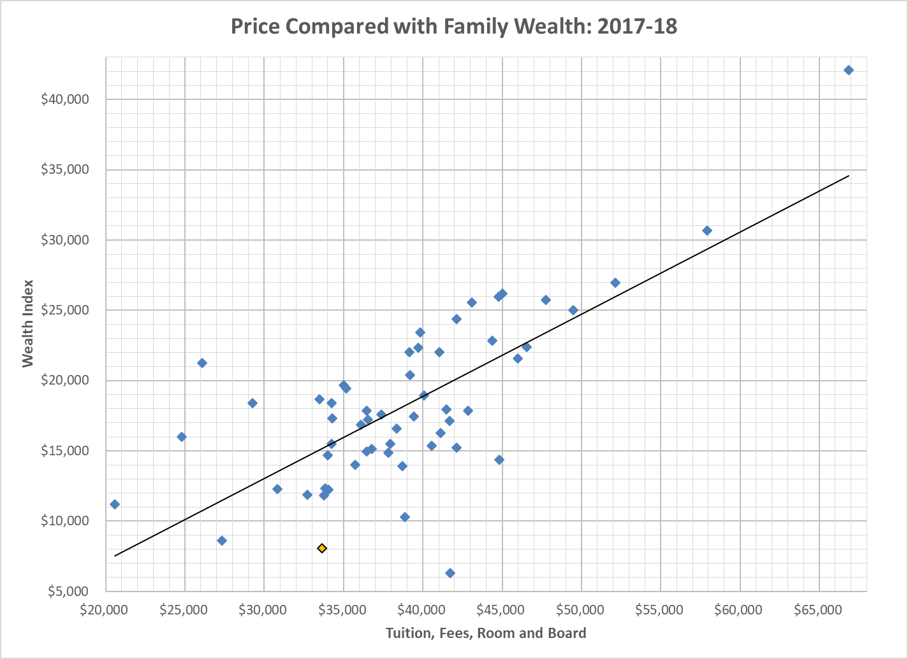
Price Compared with Family Wealth: 2017-18
Traditional Undergraduate Programs

Slide 45
Traditional Undergraduate Programs

Slide 46
Traditional Undergraduate Programs

Slide 47
Affordability Indicators for Traditional Undergraduate Programs: Student’s Perspective
  Cost of Attendance Budgets
  Financial Aid
  Student Debt
  Net Price / Family Ability to Pay

Slide 48
2018-19 On-campus Budgets (COA for students in Traditional Undergrad Programs) (see p. 20ff.)
Traditional Undergraduate Programs
Average on-campus student budget is $43,864
  Lincoln Christian $26,581
  Pepperdine $73,002
This is an increase of 5.6% from 2017-18 (compared with a 3.3% increase from 2016-17 to 2017-18).
  Up 4.4% without Pepperdine.
Notes:
2016 survey
Average dependent student budget is $39,871
Lincoln Christian $25,899
Westmont $59,410
This is an increase of 2.8% from 2015-16 (compared with a 3.3% increase from 2014-15 to 2015-16).
Average dependent student budget 38,739 in 2015-16 (fall 15 survey)

Slide 49
Traditional Undergraduate Programs

Slide 50
Tuition & Fee Changes
2017-18 to 2018-19 (see p. 24ff.)
Traditional Undergraduate Programs
Tuition and Fees at 62 reporting schools increased from an average of $29,121 to $29,967 (2.8%).
  ¼ increased tuition by 2.8% or less
    Two schools froze tuition, two schools dropped tuition (-11% and -24%)
  ¼ increased tuition by 2.9% to 3.2%
  ¼ increased tuition by 3.3% to 3.9%
  ¼ increased by more than 3.9%
    The highest reported tuition increase was 9.8%
Notes:
2016 survey
Tuition and Fees at 64 reporting schools increased from an average of $25,761 to $26,713 (3.7%).
¼ increased tuition by 2.9% or less
Lowest increase was 0.9% at 2 schools
¼ increased tuition by 3.0% to 3.4%
¼ increased tuition by 3.5% to 4.6%
¼ increased by more than 4.6%
The highest reported tuition increase was 8.4%
Tuition and Fees at 75 reporting schools increased from an average of $25,345 to $26,156 (3.2%).
¼ increased tuition by 2.8% or less
5 schools froze tuition and 2 decreased tuition
¼ increased tuition by 2.9% to 3.4%
¼ increased tuition by 3.5% to 4.6%
¼ increased by more than 4.6%
The highest reported tuition increase was 7.8%

Slide 51
Traditional Undergraduate Programs

Slide 52
Traditional Undergraduate Programs
Notes:
Includes Tuition Remission

Slide 53
Pell Grant as % of Total Enrollment
(see p. 107ff.)
 | Students in Traditional Undergrad Programs |  |  | Students in Non-Traditional Undergrad Programs
 | 2016 Survey | 2017 Survey | 2018 Survey | 2016 Survey | 2017 Survey | 2018 Survey
Minimum | 14.9% | 13.6% | 16.2% | 0% | 0% | 0%
1st Quartile | 27.6% | 29.5% | 27.2% | 30.0% | 30.4% | 32.9%
Median | 35.6% | 34.7% | 33.4% | 42.6% | 44.6% | 46.4%
3rd Quartile | 42.4% | 41.6% | 42.4% | 53.3% | 54.4% | 57.1%
Maximum | 57.8% | 54.4% | 58.2% | 76.0% | 98.1% | 100+%
# Schools reporting Pell recipients | 60 | 63 | 62 | 36 | 45 | 43
Notes:
Lipscomb is min 2014 traditional
Fresno Pacific max 2014 at 95% (likely bad data); 100.9%

Slide 54
Traditional Undergraduate Programs

Slide 55
Traditional Undergraduate Programs

Slide 56
2017-18 Borrowing: Average per Enrolled Student (see p. 61-62)
Traditional Undergraduate Programs
Perkins $177
Subsidized $2,177
Unsubsidized $2,042
Other $1,261
PLUS $1,846
Total $7,503

Slide 57
Traditional Undergraduate Programs

Slide 58
2017-18 Total Financial Aid
(see pp. 67ff.)
Traditional Undergraduate Programs
Students in traditional undergrad programs at 62 institutions received $2.3 billion of financial aid in 2017-18.
  $1.681 billion in gift aid (73%)
  $ 562 million in student loans (24%)
  $ 60 million in employment (3%)

Slide 59
Traditional Undergraduate Programs

Slide 60
Traditional Undergraduate Programs

Slide 61
Average Student Loan Debt
(see p. 93ff.)
Traditional Undergraduate Programs
On average 72% of FY18 graduates at 60 responding schools borrowed student loans (range: 44% to 100%).
Their average debt was $29,570 (range: $14,194 to $39,930).
  30 of 60 (50%) of responding schools had average debts ranging from $26,660 to $33,088
The average debt, at schools where students borrowed, equaled 102% of 2017-2018 tuition and fees at each student’s school (range: 40% to 212%).
Notes:
Percent borrowed

Slide 62
3-Year Cohort Default Rates
Most recent three-year default rate on government loans (FY2015 official).
National Average Default Rate – All Schools (10.8%)
National Average Default Rate – Private 4-Year (6.6%)
SOURCE: U.S. Department of Education Default Management, Official Cohort Default Rates for Schools, retrieved 12.20.2018 https://www2.ed.gov/offices/OSFAP/defaultmanagement/cdr.html

Slide 63
Traditional Undergraduate Programs

Slide 64
Traditional Undergraduate Programs

Slide 65
Implications for our Schools (discussion)

Slide 66

Questions?
Contact Dan Nelson or Jeff Olson if you have specific questions
  dcnelson@bethel.edu
  jeff-olson@bethel.edu
Email the CCCU financial aid administrators e-list to foster a broader conversation

